Slide 1

IMPROVED FAULTS DETECTION AND DIAGNOSIS OF AN ELECTRICAL MACHINE-DEEP LEARNING BASED APPROCHES
By:
SEDDI Youcef
SENNOUSSI Chakib Salah Eddine

Slide 2

INTRODUCTION
DATA-BASE ANLYSIS
01
03
ML GENERALITIES
FAULTS DETECTION
02
04
CONCLUSION
Visualisation and Analysis of our data-sets and signals
05
A small conclusion of our work
A brief of our study aim
Generalties on the machine learning
Bearing faults diagnosis and detection

Slide 3
INTRODUCTION
01
A brief of our study aim

Slide 4

WHAT ARE INDUCTION MOTORS ?
Induction motor, is an electrical machine powered by a system of alternating voltages and currents.
Induction motor is made up of two parts that are important to its operation: the stator and the rotor.
Notes:
Induction motor, also known as an The asynchronous motor, is an electrical machine powered by a system of alternating voltages and currents.
Induction motor is made up of two parts that are important to its operation: the stator (Usually the fixed part) and the rotor (usually the rotating part) in addition to mechanical parts allowing the rotation of the rotor and the holding of the different sub-assemblies.

Slide 5
WHY USE INDUCTION MOTORS ?
In this modern world, machines play a crucial role in different industries and they have replaced the need for labor work. With the tremendous development in technology ,dependence on manual work is decreased significantly.
Notes:
In this modern world, machines play a crucial role in different industries and they have replaced the need for labor work. With the tremendous development in technology dependence on manual work is decreased significantly.
The induction represent approximately 80% of all motors used in industry and for all kinds of applications such as trains (e.g. Eurostar) (e.g. Eurostar), hoisting systems, production line drives, robotics, ventilation, and many other areas. That's mainly due to its robustness ,excellent reliability ,low cost with high efficiency.

Slide 6
INDUCTION MOTORS FAILURES
Despite all the induction motor qualities It’s prone to failures , These failures can lead to excessive deterioration of the production ,which can lead to significant costs and therefore loss of revenue.
Notes:
Despite all the induction motor qualities It’s prone to failures , which can be subject to internal and external stresses inherent in the machine itself or in the operating conditions; Critical failures in the electrical and mechanical . These failures can lead to excessive deterioration of the production process ,forcing them to stop , also unplanned maintenance can lead to significant costs and therefore loss of revenue.

Slide 7
Bearing failures
Bearings play a very important role in the operation of all types of electrical machines. In general, rolling bearings are made up of an outer and an inner race which are separated by cylindrical balls and rollers.
Notes:
Bearings play a very important role in the operation of all types of electrical machines , it can represent about 44% of all motor failures .There are many causes of bearing failure, such as lubricant contamination, excessive load or electrical causes such as overloading. In general, rolling bearings are made up of an outer and an inner race which are separated by cylindrical balls and rollers.

Slide 8
Bearing failures
Notes:
Bearings play a very important role in the operation of all types of electrical machines , it can represent about 44% of all motor failures .There are many causes of bearing failure, such as lubricant contamination, excessive load or electrical causes such as overloading. In general, rolling bearings are made up of an outer and an inner race which are separated by cylindrical balls and rollers.

Slide 9
INDUCTION MOTORS FAULTS DETECTION
A great deal of research has been carried out to develop various methods capable to detect serious failures in order to limit them by avoiding catastrophic failure conditions .
One of the recent failures detection is detection using artificial intelligence .
Notes:
A great deal of research has been carried out to develop various methods capable of not just detect serious failures but also estimate the remaining lifetime of a machine in order to limit them by avoiding catastrophic failure conditions .
One of the recent failures detection techniques who proved to have great detection and efficiency of results is detection using artificial intelligence .

Slide 10
MACHINE LEARNING GENERALITIES
02
Generalities on the machine learning

Slide 11
WHAT IS AI ?
Artificial intelligence is a field, which combines robust data-sets and computer science, to enable problem-solving.
Notes:
Artificial intelligence is a field, which combines robust data-sets and computer science, to enable problem-solving. It also encompasses fields of machine learning and deep learning, which are frequently mentioned in conjunction with AI. These disciplines are comprised of artificial intelligence algorithms which seek to create expert systems which make classifications or predictions based on input data.

Slide 12
WHAT IS THE DIFFERENCE BETWEEN AI , ML , DL
We can say that machine learning is a sub-field of artificial intelligence. Deep learning is a sub-field of machine learning, and neural networks make up the backbone of deep learning algorithms.
Notes:
We can say that machine learning is a sub-field of artificial intelligence. Deep learning is a sub-field of machine learning, and neural networks make up the backbone of deep learning algorithms. In fact, it is the number of node layers, or depth, of neural networks that distinguishes a single neural network from a deep learning algorithm, which must have more than three.

Slide 13
WHAT IS DIFFERENCT BETWEEN AI , ML , DL
Artificial intelligence
Machine learning
Neural networks
Deep learning

Slide 14





MACHINE LEARNING FOR IM FAULTS DETECTION
Trained ML models
Faults data
Detection results
Notes:
As we have seen machine learning use data-sets and computer science, to enable problem-solving , which means we will be able to use it for diagnosis and detection of industry machinery faults , more specifically induction motor bearing faults .

Slide 15
DATA-BASE ANALYSIS
03
Visualization and Analysis of our data-sets and signals

Slide 16
PRESENTATION OF THE USED DATA-BASE
Data and with big amount is collected from industry and however obtaining the appropriate data with the quality and quantity needed is still challenging for research . For our study we used a bench-mark data set provided by Paderborn University .
Notes:
Data and with big amount is collected from industry and science , some is made public and can be accessed from websites and repositories , however obtaining the appropriate data with the quality and quantity needed is still challenging for research . For our study we used a bench-mark data set provided by Paderborn University .Table below shows principal characteristics of the data we took :

Slide 17
View on the data signals
To make a view on the data-set , we will apply envelope technique to the signals , for vibration and currents measurements we will find next results

Slide 18
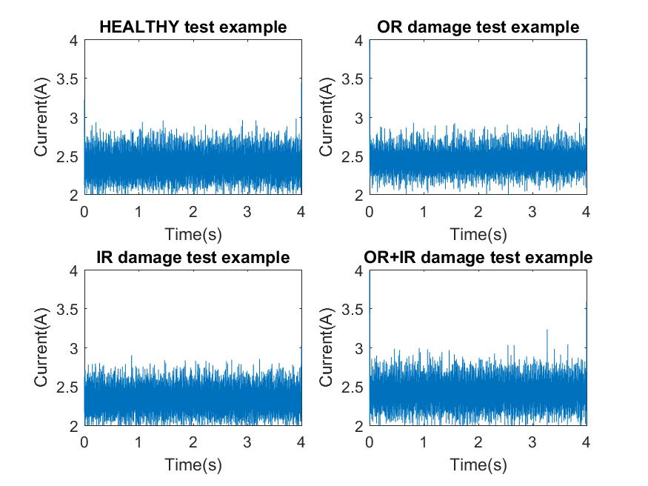
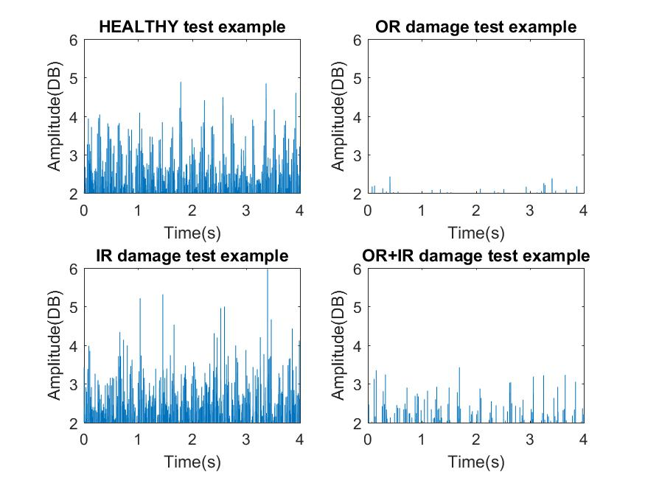
View on the data signals
Current
Vibration

Slide 19
Clustering different health states of bearings
By using wavelet packet decomposition we were able to visualize different clustering of health states of bearing, which means that good results might be obtained with machine learning algorithms

Slide 20
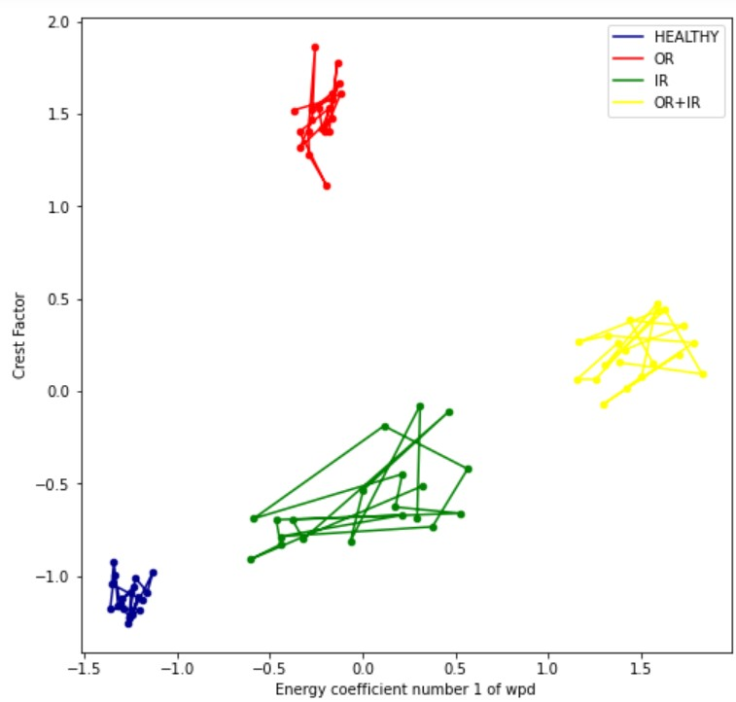
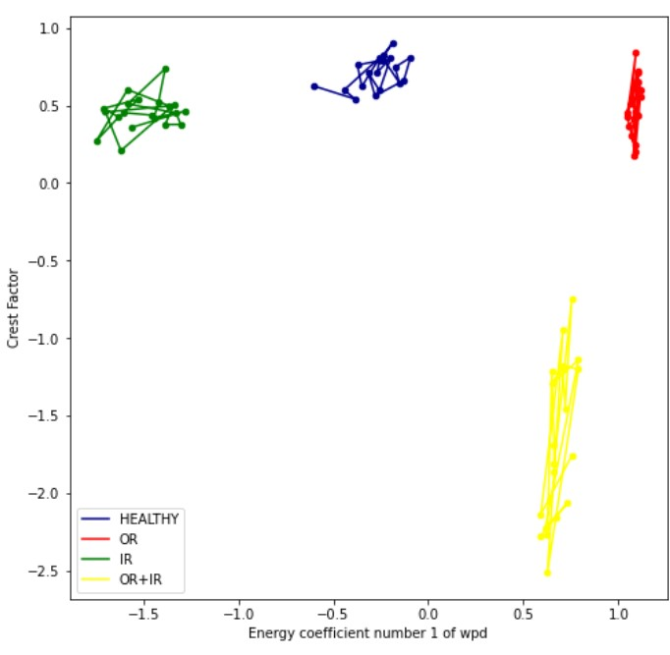
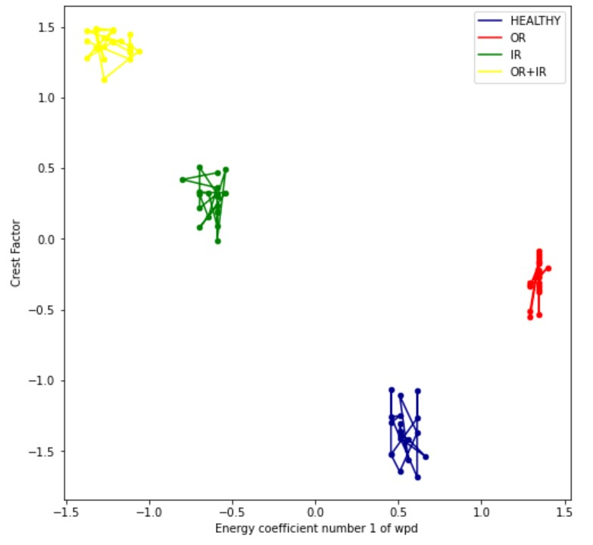
Clustering different health states of bearings
Vibration
Torque
Force

Slide 21
FAULTS DETECTION AND DIAGNOSIS
04
Bearing faults diagnosis and detection

Slide 22
Work plan
We will be using MLP as our principal algorithm for our studies and we will make comparisons of results to SVM and KNN algorithms , the architecture of the MLP we have used can be seen in the figure below.
Notes:
Pattern recognition techniques have been investigated as useful and powerful tools to detect faults, AI techniques include several sophisticated approaches such as fuzzy logic , Artificial neural network (ANN),support vector machine (SVM),decision tree , K-nearest neighbors (KNN).
We will be using MLP (Multi Layer Perceptron) as our principal algorithm for our studies and we will make comparisons of results to SVM and KNN algorithms , the architecture of the MLP we have used can be seen in the figure below (For simplification we used reduced number of neurons)

Slide 23
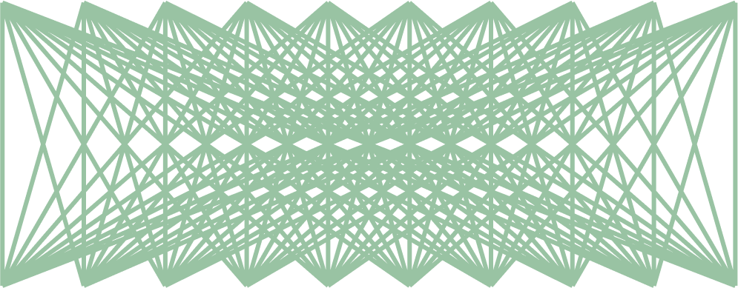
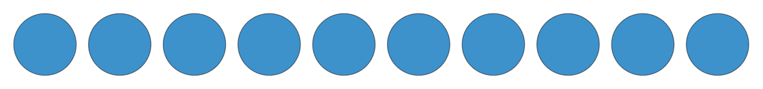
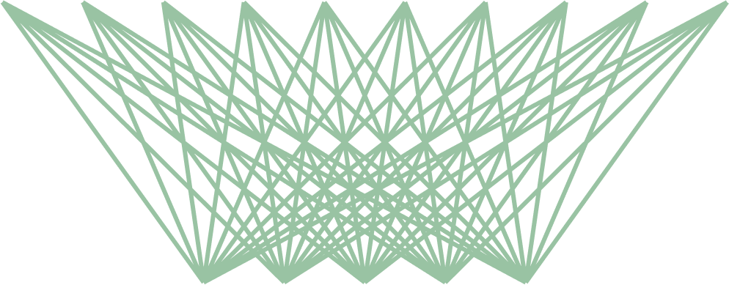
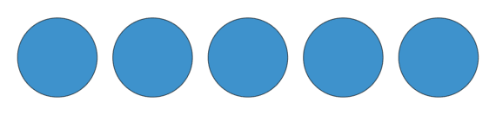
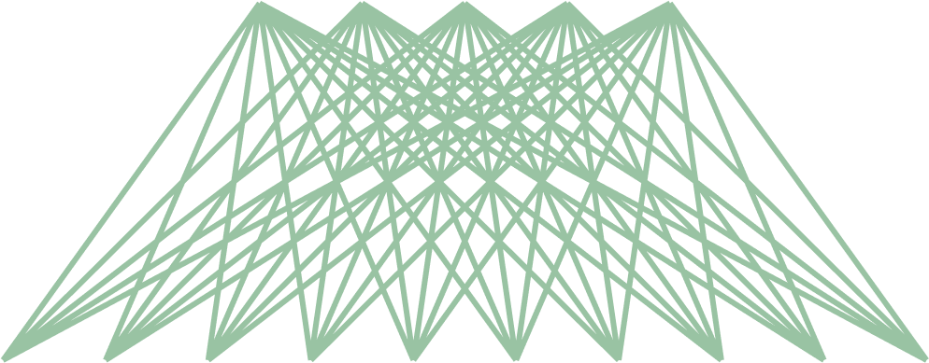
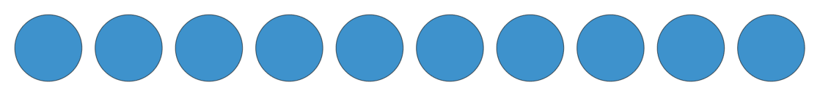
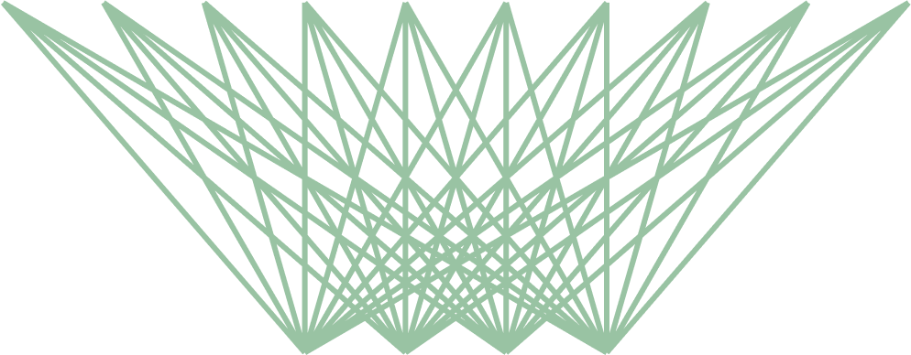

Input layer
(Input features)
First hidden layer 20 neurons
Second hidden layer 10 neurons
Third hidden layer 20 neurons
Output layer of 4 neurons (Healthy,OR,IR,OR_IR )

Slide 24
Accuracy results using envelope and FFT signals
We will use envelope and FFT of signals as inputs for the algorithms , for that we will take 5000 points from each signal and use them as features(plus three features that represent operating condition parameters).

Slide 25
Accuracy score results using envelope
 | SVM | KNN | MLP
Current | 0.315972 | 0.350964 | 0.277778
Vibration | 0.520883 | 0.39906 | 0.395833
Torque | 0.378472 | 0.656250 | 0.274306
Speed | 0.284722 | 0.406250 | 0.201389

Slide 26
Using FFT to the envelope signals
 | SVM | KNN | MLP
Current | 0.486111 | 0.190972 | 0.427083
Vibration | 0.760417 | 0.496528 | 0.597222
Torque | 0.857639 | 0.798611 | 0.850694
Speed | 0.291667 | 0.288194 | 0.309028

Slide 27
Results Discussion
Prediction accuracy that obtained from using envelope signal was not
However using FFT signal as input increased the accuracy , and gave results which can be satisfying .
Notes:
Prediction accuracy that obtained from using envelope signal was not satisfying as the higher accuracy is 65.62% which was obtained using torque signal with KNN algorithm .
However using FFT signal as input increased the accuracy , the higher accuracy obtained was 85.76% which can be satisfying .

Slide 28

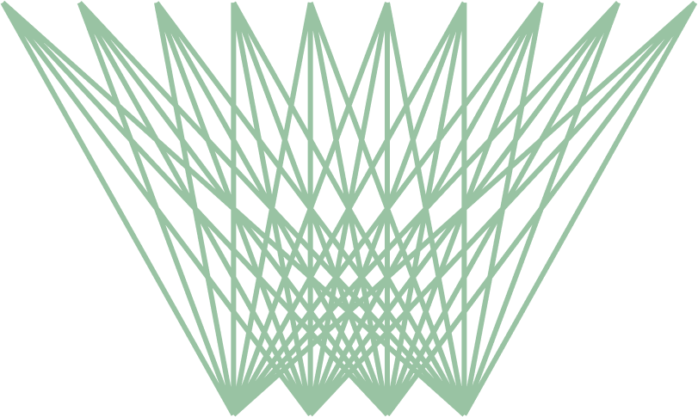

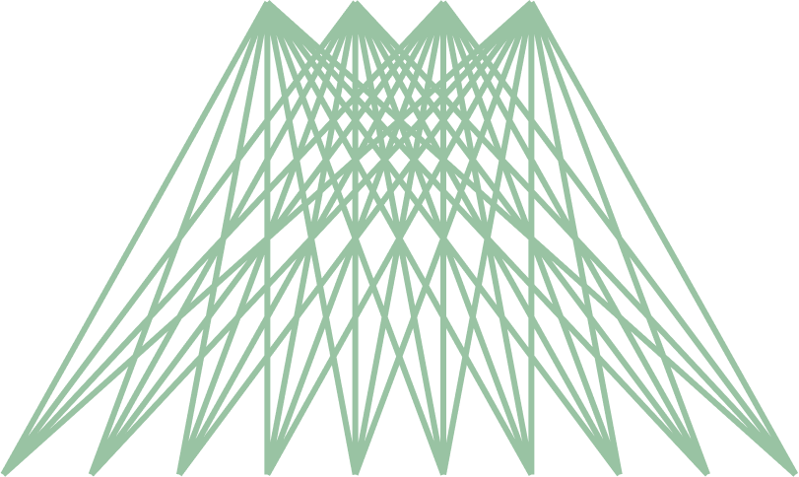

Optimization by features extraction
5000 features
20 extracted features

Slide 29
Envelope signals extracted features
 | SVM | KNN | MLP
Current | 0.288194 | 0.930556 | 0.538194
Vibration | 0.947917 | 0.916667 | 0.975694
Torque | 0.409722 | 1.000000 | 0.989583
Speed | 0.291667 | 1.000000 | 1.000000

Slide 30
FFT to the envelope extracted features
 | SVM | KNN | MLP
Current | 0.805556 | 0.951389 | 0.947917
Vibration | 0.666667 | 0.881944 | 0.927083
Torque | 0.982639 | 0.993056 | 0.996528
Speed | 0.996528 | 0.996528 | 0.993056

Slide 31
Combining extracted features
 | SVM | KNN | MLP
Current | 0.788194 | 0.954861 | 0.972222
Vibration | 0.975694 | 0.982639 | 0.993056
Torque | 0.934028 | 0.993056 | 1.000000
Speed | 1.000000 | 1.000000 | 1.000000

Slide 32
Results Discussion
We have seen the extracting features had a huge impact on the accuracy score , and it’s totally logic, since having a lot of features leads to an overfiting model . Mostly total correct prediction obtained using combined features with MLP
Notes:
We have seen the extracting features had a huge impact on the accuracy score , and it’s totally logic, since having a lot of features (5000 features) leads to an overfiting model . Mostly total correct prediction obtained using combined features with MLP
Extracting features is the way to prevent that . There were still a possible way to also improve the accuracy , and it was by combining the extracted features which gave correct prediction for almost all the tested samples.

Slide 33
Conclusion
05
A small of conclusion of our work

Slide 34
Conslusion
The use of AI made the detection and diagnosis of faults more accurate and powerful , and we can that our application which made almost a perfect prediction of different beating health state can help to prevent failures which can lead to high costs in applications because of downtimes and maintenance cost.
Notes:
The use of AI made the detection and diagnosis of faults more accurate and
powerful , and in our application we made the use of that and showed more
specifically how can the deep learning (features extraction using unsupervised
learning) optimize and cause a wide improvement in the detection accuracy .
By that , our application which made almost a perfect prediction of different
beating health state can help to prevent failures which can lead to high costs in
applications because of downtimes and maintenance cost.

Slide 35

THANKS FOR YOUR ATTENTION

